Slide 1
Spring Security And Monitoring
​

Slide 2
Security

Slide 3
Security
Intro
Authentication Types
Cors

Slide 4
Security
Intro
Authentication Types
Cors

Slide 5
Hypertext Transfer Protocol – History
1991
HTTP/0.9
1997
HTTP/1.1
2022
HTTP/3.0
1990
2040
1996
HTTP/1.0
2015
HTTP/2.0
Source: https://developer.mozilla.org/en-US/docs/Web/HTTP/Basics_of_HTTP/Evolution_of_HTTP

Slide 6
HTTP/0.9 - Overview
Only possible file type was HTML
Error Handling over HTML pages
No Header
No Status Codes

Slide 7
HTTP/0.9 - HTTP Methods
Method | Description
GET | Retrieve information from server

Slide 8
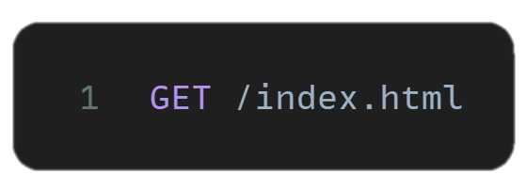
HTTP/0.9 - Retrieve HTML
HTTP Method
Target Uniform Resource Identifier URI

Slide 9
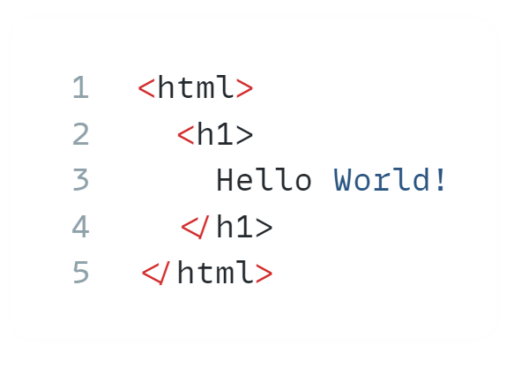
HTTP/0.9 - Retrieve HTML

Slide 10
HTTP/1.0 - Overview
Start of versioned protocol
Headers
Status code
Error code

Slide 11
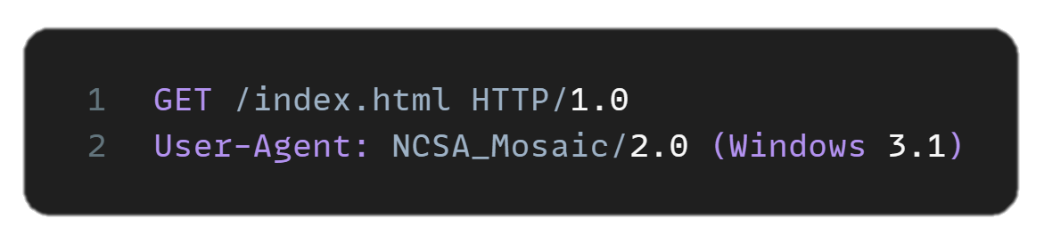
HTTP/1.0 - Retrieve HTML
HTTP Version used to make request
Identification of application requesting resource

Slide 12
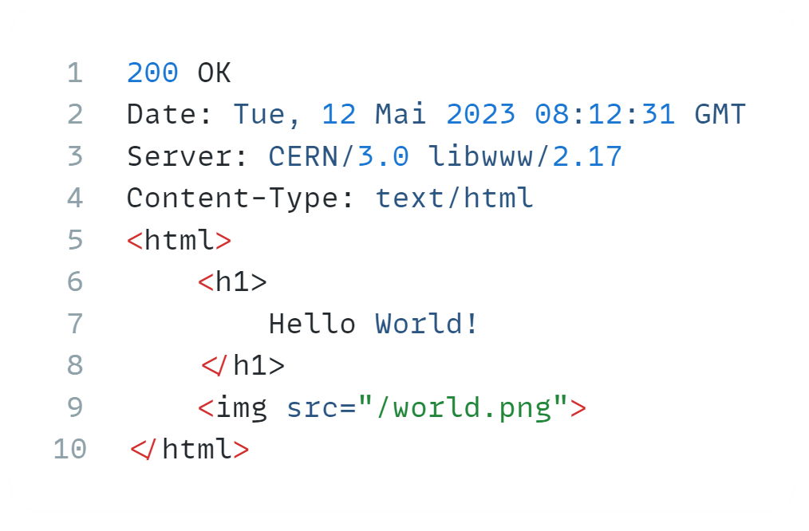
HTTP/1.0 - Retrieve HTML
When and from where the response came from
The format of the response body
Result code of request

Slide 13
HTTP/1.0 - Retrieve HTML

Slide 14
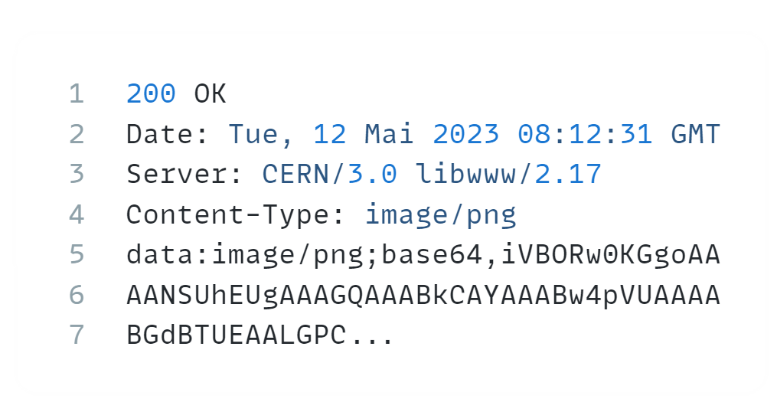
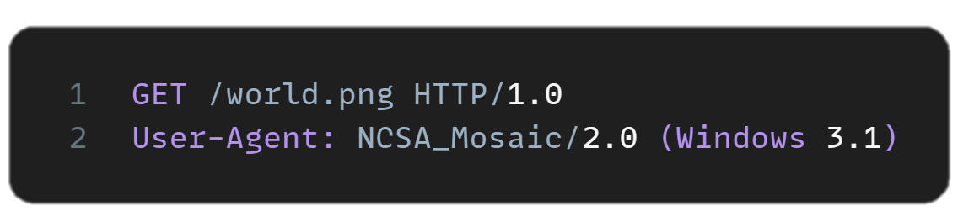
HTTP/1.0 - Retrieve Image

Slide 15
HTTP/1.0 - Added HTTP Methods
Method | Description
HEAD | Similar to GET but without body information
POST | Request server to accept resources in body
Source: https://datatracker.ietf.org/doc/html/rfc1945#section-8

Slide 16
HTTP/1.0 - HTTP Status codes
Code | Signification | Code
1xx | Reserved value range for informational response | 300 | Multiple Choices - Default for any 3xx response
200 | OK | 301 | Moved permanently
201 | Created | 302 | Moved temporarily
202 | Accepted – Uncommitted reception | 304 | Not Modified
204 | No Content
Source: https://datatracker.ietf.org/doc/html/rfc1945#section-8

Slide 17
HTTP/1.0 - HTTP Status codes
Code | Signification | Code | Signification
400 | Bad Request | 500 | Internal Server Error
401 | Unauthorized | 501 | Not Implemented
403 | Forbidden | 502 | Bad Gateway
404 | Not found | 503 | Service unavailable
Source: https://datatracker.ietf.org/doc/html/rfc1945#section-8

Slide 18
HTTP/1.1 - Overview
Added more methods
Pipelining for parallel request handling
Chunking for splitting big payloads
Content negotiations for simpler connections

Slide 19
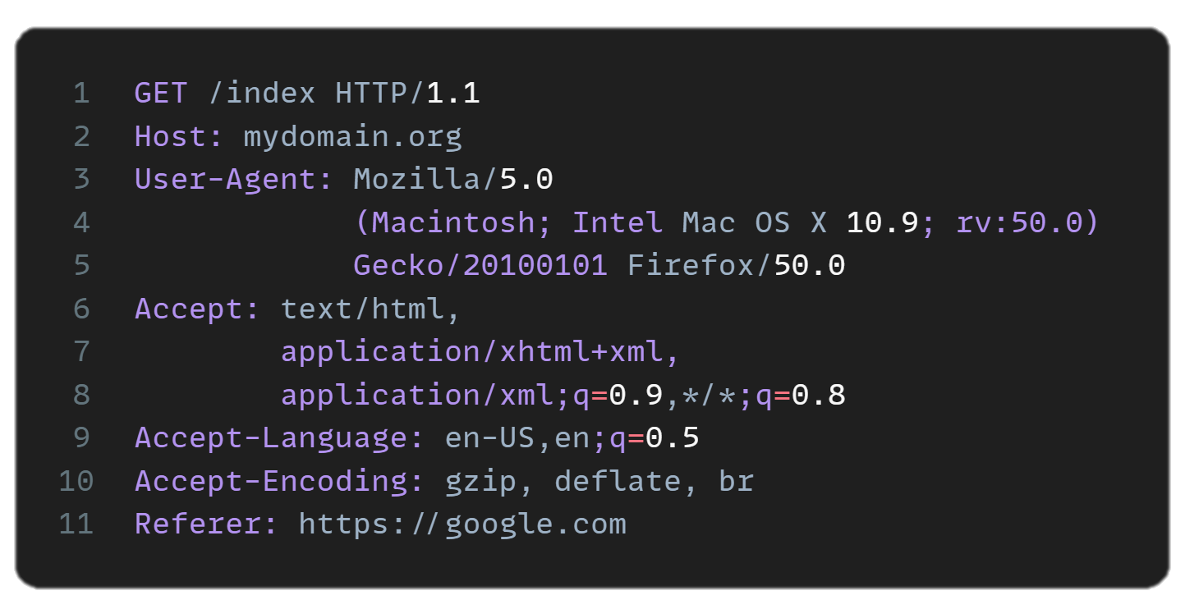
HTTP/1.1 - Retrieve HTML
Supported content types
Language of HTTP client (not selected by user)
Supported Encodings
Address from where request comes

Slide 20
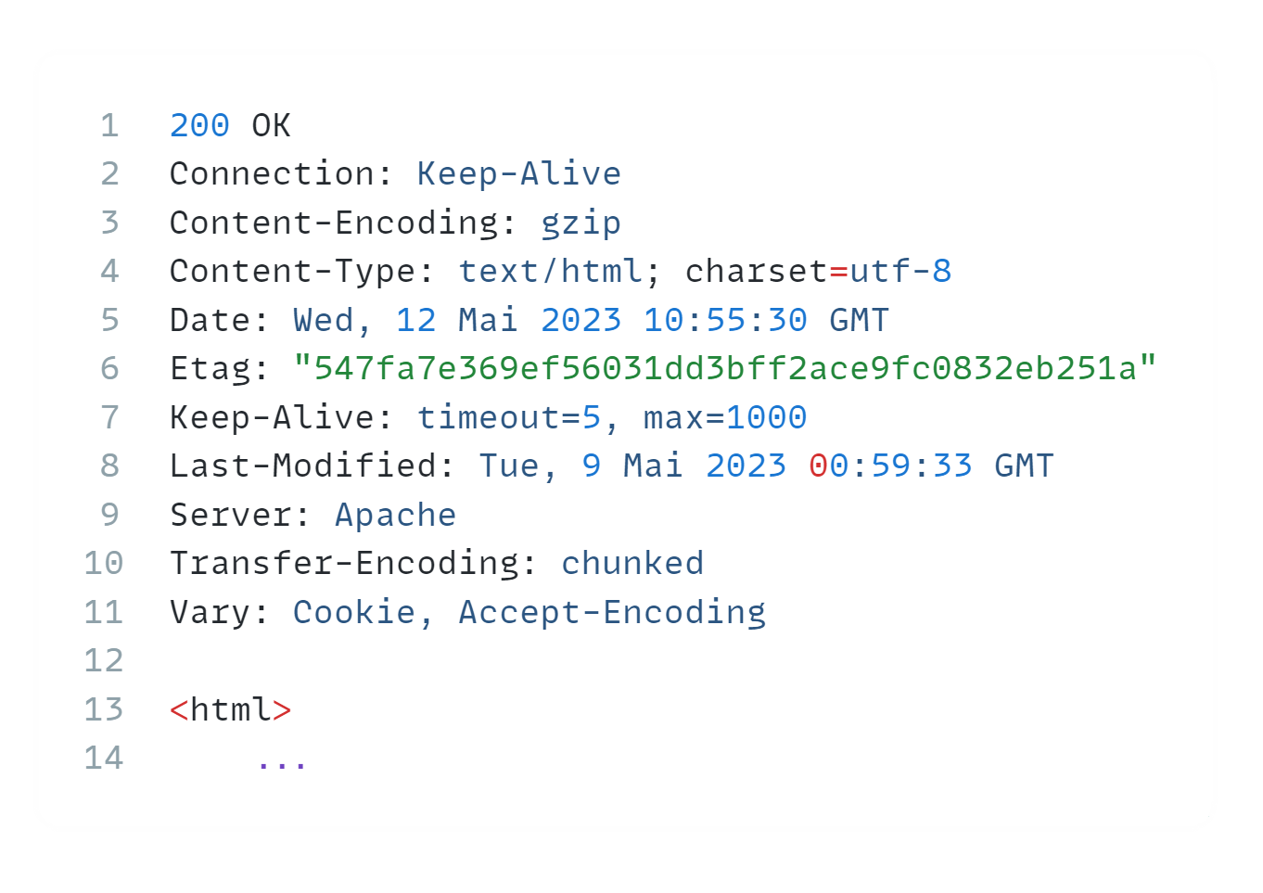
HTTP/1.1 - Retrieve HTML

Slide 21
HTTP/1.1 - Retrieve HTML
Should network connection be persisted

Slide 22
HTTP/1.1 - Retrieve HTML
Result of content negotiation

Slide 23
HTTP/1.1 - Retrieve HTML

Slide 24
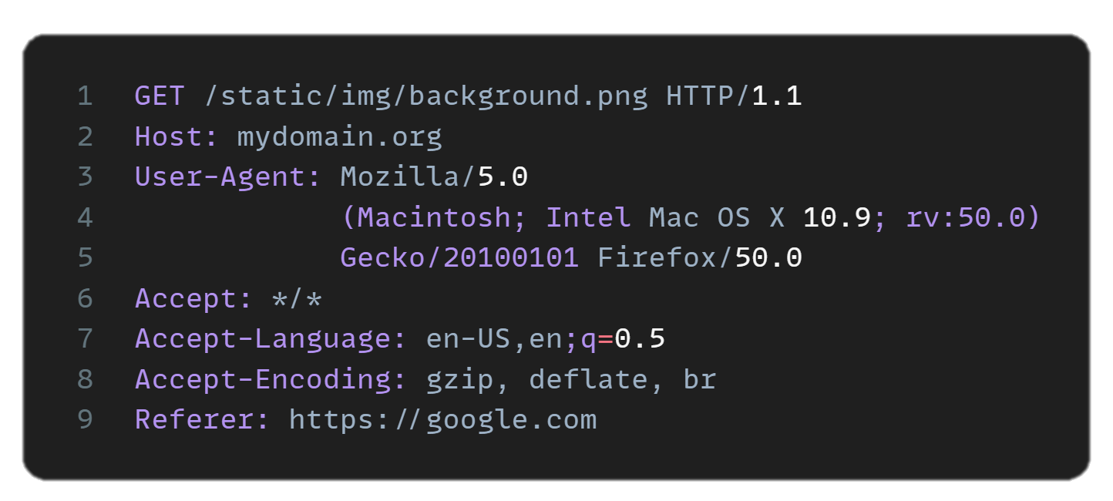
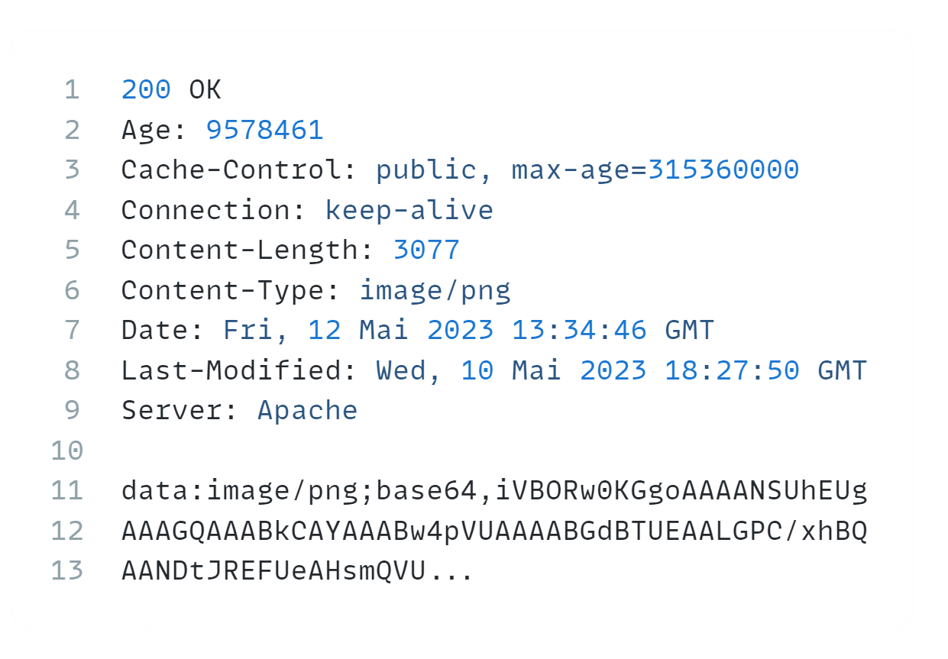
HTTP/1.1 - Retrieve Image

Slide 25
HTTP/1.1 – Added HTTP Methods
Method | Description
PUT | Request for update of an already existing server resource
DELETE | Request for deletion of a server resource
TRACE* | Request for loop back of request message
Source: https://datatracker.ietf.org/doc/html/rfc2068#section-9
https://my.f5.com/manage/s/article/K85840901

Slide 26
HTTP/1.1 - Added HTTP Status codes
Code | Signification | Code
100 | Continue | 303 | See other
101 | Switching Protocols | 305 | Use Proxy
203 | Non Authoritative Information
205 | Reset Content
206 | Partial content
Source: https://datatracker.ietf.org/doc/html/rfc2068#section-10.1

Slide 27
HTTP/1.1 - HTTP Status codes
Code | Signification | Code | Signification
402 | Payment required | 410 | Gone
405 | Method not allowed | 411 | Length required
406 | Not Acceptable | 412 | Precondition failed
407 | Proxy authentication required | 413 | Request entity too large
408 | Request timeout | 414 | Request URI too long
409 | Conflict | 415 | Unsupported media type
Source: https://datatracker.ietf.org/doc/html/rfc2068#section-10.1

Slide 28
HTTP/1.1 - HTTP Status codes
Code | Signification | Code | Signification
504 | Gateway timeout | 505 | HTTP Version not supported
Source: https://datatracker.ietf.org/doc/html/rfc2068#section-10.1

Slide 29
HTTP – Working Group
IETF HTTP Working Group (httpwg.org)
Source: https://datatracker.ietf.org/doc/html/rfc2068#section-10.1

Slide 30
Security
Intro
Authentication Types
Cors

Slide 31
Authentication vs. Authorization
Authentication (usually first) | Authorization (usually second)
Is Client who they say they are? | What can Client access? And what not?
Does Client have required credentials? | What level of access does Client have? (CRUD)
 | What policies and rules do apply to Client?
Source: https://auth0.com/docs/get-started/identity-fundamentals/authentication-and-authorization

Slide 32
Authentication Factors
Knowledge something you know | Possession something you have | Inherence something you are | Location somewhere you are | Behavior something you do
Password | Token | Biometric | Network | Point Grid
Secret | Certificate |  | Geolocation
Pin
Source: https://www.sumologic.com/glossary/authentication-factor/#:~:text=The%20five%20main%20authentication%20factor,location%20factors%2C%20and%20behavior%20factors.

Slide 33









Multifactor Authentication
Password
Verification

Slide 34
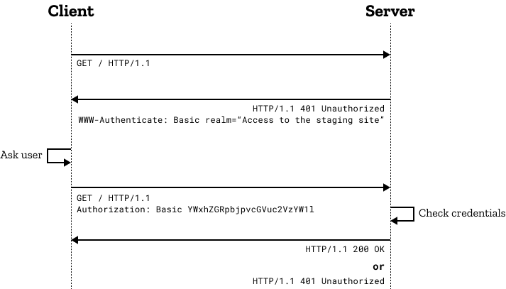
HTTP Basic Auth
Minimal security measure
Base64 encoding not encryption
Authentication Secret will be sent in HTTP Header
For UTF-8 support Server has to enable it over HTTP Header
Source: https://developer.mozilla.org/en-US/docs/Web/HTTP/Authentication

Slide 35
Security
Intro
Authentication Types
Cors

Slide 36
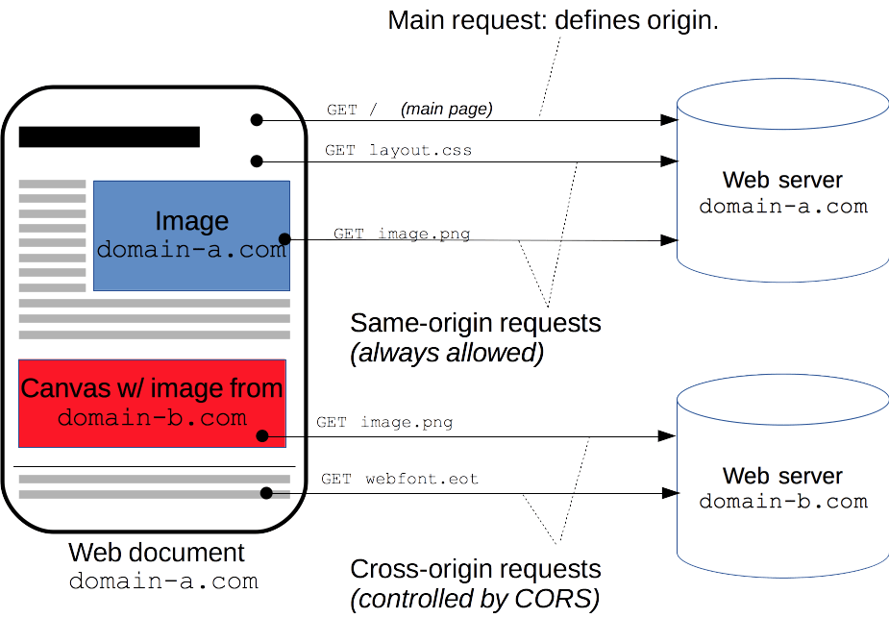
Cross-Origin Resource Sharing CORS
Getting Resources from different origins
Source: https://developer.mozilla.org/en-US/docs/Web/HTTP/CORS

Slide 37

15 min break & Setup the laptops
Repository
ti8m-academy/spring-security-and-monitoring
https://gitlab.ti8m.ch/ti8m-academy/spring-security-and-monitoring
Rest call -> postman
Ide (for run configurations) Intellij Idea

Slide 38
Security – Basic

Slide 39
Security – Basic
Intro
Configuration
Default User
In Memory User
Password Encoding
Authorization
Database Integration
Annotations

Slide 40
Security – Basic
Intro
Configuration
Default User
In Memory User
Password Encoding
Authorization
Database Integration
Annotations

Slide 41
Spring Filter Chain

Slide 42
Spring Filter Chain
A request from the client to the servlet that menages it pass through multiple filters

Slide 43
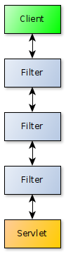
Spring Filter Chain
A request from the client to the servlet that menages it pass through multiple filters

Slide 44
Spring Filter Chain
A request from the client to the servlet that menages it pass through multiple filters
Each filter is a bean and can:
Handle the request itself, interrupting the chain
Modify the request
Modify the response

Slide 45
Spring Filter Chain
A request from the client to the servlet that menages it pass through multiple filters
Each filter is a bean and can:
Handle the request itself, interrupting the chain
Modify the request
Modify the response
The order of the filters is very important, it can be managed by
@Ordered annotation
Implement Ordered

Slide 46
Spring Security Filter
Spring Security is installed as a filter of this chain

Slide 47
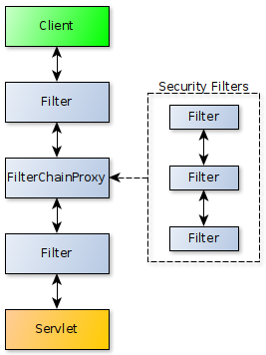
Spring Security Filter
Spring Security is installed as a filter of this chain

Slide 48
Spring Security Filter
Spring Security is installed as a filter of this chain
FilterChainProxy is the concrete implementation

Slide 49
Spring Security Filter
Spring Security is installed as a filter of this chain
FilterChainProxy is the concrete implementation
Even if from the big picture it is only one filter, in fact it delegates processing to internal filters

Slide 50
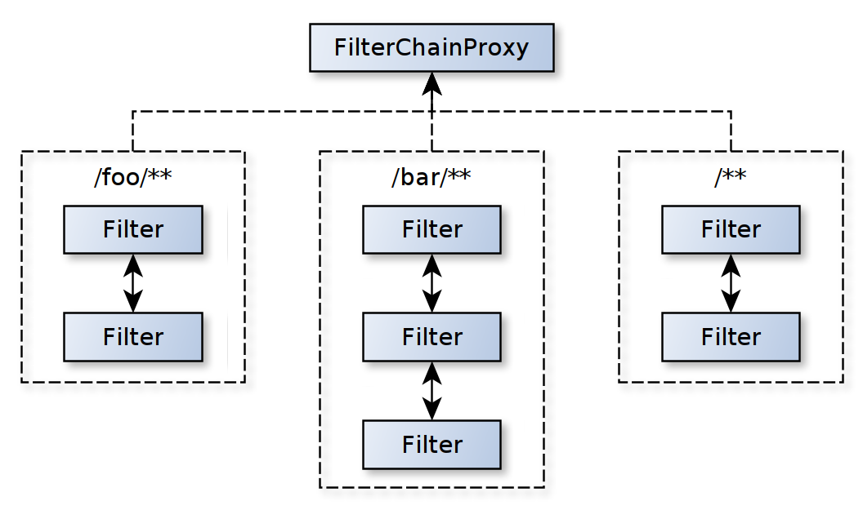
Spring Security Filter
The filter chain proxy dispatches the request to the first matching filter chain

Slide 51
Security – Basic
Intro
Configuration
Default User
In Memory User
Password Encoding
Authorization
Database Integration
Annotations

Slide 52
Spring Security – Configuration Classes
SecurityFilterChain
It defines a single security filter chain used in the FilterChainProxy

Slide 53
Spring Security – Configuration Classes
SecurityFilterChain
It defines a single security filter chain used in the FilterChainProxy
HttpSecurity (builder)
It allows configuring web security for http requests
It defines the rules that applies to a security filter chain

Slide 54
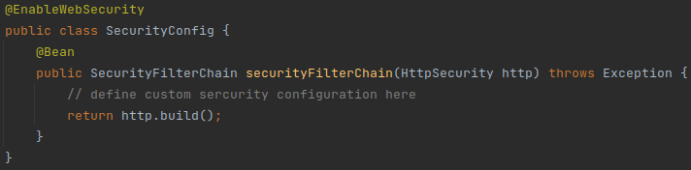
Spring Security – Configuration Bean

Slide 55
Spring Security – Configuration Bean – Step 1
Initialize the http requests authorization configuration
HttpSecurity.authorizeRequests()

Slide 56
Spring Security – Configuration Bean – Step 2
Target the http requests types
Targes
.anyRequest()
.antMatchers(HttpMethod)
.antMatchers(HttpMethod, String...)
.antMatchers(String...)

Slide 57
Spring Security – Configuration Bean – Step 3
Manage the access
Authorization
permitAll()
denyAll()
authenticated()
hasRole(String)
hasAnyRole(String...)
hasAuthority(String)
hasAnyAuthority(String...)

Slide 58
Spring Security – Exercise Basic #1
Open /default/open to anyone
Branch: security-basic/exercise_1

Slide 59
Security – Basic
Intro
Configuration
Default User
In Memory User
Password Encoding
Authorization
Database Integration
Annotations

Slide 60
Spring Security – Basic Auth Default User
Users are managed by UserDetails configuration bean

Slide 61
Spring Security – Basic Auth Default User
Users are managed by UserDetails configuration bean
When this bean is not provided, a default user is generated
Username: user
Password: logged in the console (uuid)

Slide 62
Spring Security – Basic Auth Default User
Default user name and password are configurable on yaml
spring.security.user.name
spring.security.user.password

Slide 63
Spring Security – Basic Auth Default User
Default user name and password are configurable on yaml
spring.security.user.name
spring.security.user.password
Or can be disable by excluding
UserDetailsServiceAutoConfiguration

Slide 64
Spring Security – Basic Auth Default User
In order to correctly authenticate the default basic auth user in the service, it is necessary to activate the basic auth mechanism
HttpSecurity.httpBasic()

Slide 65
Spring Security – Exercise Basic #2
Customize the default user
Username: default
Password: password
User basic authentication
Require authenticated requests (except open endpoint)
Branch: security-basic/exercize_2

Slide 66
Security – Basic
Intro
Configuration
Default User
In Memory User
Password Encoding
Authorization
Database Integration
Annotations

Slide 67
Spring Security – In Memory User
It is possible to avoid to use the default user and add multiple users to the service by providing an InMemoryUserDetailsManager bean

Slide 68
Spring Security – In Memory User
It is possible to avoid to use the default user and add multiple users to the service by providing an InMemoryUserDetailsManager bean
The manager takes an array of UserDetails

Slide 69
Spring Security – In Memory User
It is possible to avoid to use the default user and add multiple users to the service by providing an InMemoryUserDetailsManager bean
The manager takes an array of UserDetails
An UserDetails can be generate using the User builder

Slide 70
Spring Security – In Memory User - UserDetails
The User builder starts with the user name definition
withUsername(String)

Slide 71
Spring Security – In Memory User - UserDetails
The User builder starts with the user name definition
withUsername(String)
And can be customized by
password(String)
roles(String...)
authorities(String...)
disabled(boolean)

Slide 72
Spring Security – In Memory User - UserDetails
The User builder starts with the user name definition
withUsername(String)
And can be customized by
password(String)
roles(String...)
authorities(String...)
disabled(boolean)
The UserDetails are created by the build() method

Slide 73
Security – Basic
Intro
Configuration
Default User
In Memory User
Password Encoding
Authorization
Database Integration
Annotations

Slide 74
Spring Security – Password Encoding
The PasswordEncoder bean is responsible for encoding and validate passwords

Slide 75
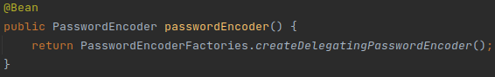
Spring Security – Password Encoding
The PasswordEncoder bean is responsible for encoding and validate passwords
It can be generated using the PasswordEncoderFactories

Slide 76
Spring Security – Password Encoding
When using password in an application it is a best practice to do not have is as raw text but encoded

Slide 77
Spring Security – Password Encoding
When using password in an application it is a best practice to do not have is as raw text but encoded
An encoded password looks like
{<encoderType>}<encodedPassword>

Slide 78
Spring Security – Password Encoding
When using password in an application it is a best practice to do not have is as raw text but encoded
An encoded password looks like
{<encoderType>}<encodedPassword>
Where some encoder types are:
noop (raw)
bcrypt
MD5
SHA-256

Slide 79
Spring Security – Exercise Basic #3
Create the in-memory users
Admin
password: admin-password
User
password: user-password
Verify users can access /default/authenticated endpiont
Branch: security-basic/exercize_3

Slide 80
Security – Basic
Intro
Configuration
Default User
In Memory User
Password Encoding
Authorization
Database Integration
Annotations

Slide 81
Spring Security – Authorities
Represents an individual privilege

Slide 82
Spring Security – Authorities
Represents an individual privilege
It has any naming convention (just CONSTANT_CASE)

Slide 83
Spring Security – Authorities
Represents an individual privilege
It has any naming convention (just CONSTANT_CASE)
Example
READ_AUTHORITY
WRITE_PRIVILEGE
CAN_DELETE

Slide 84
Spring Security - Roles
It is an authorities wrapper

Slide 85
Spring Security - Roles
It is an authorities wrapper
It grants automatically the authority ROLE_<role_name>

Slide 86
Spring Security - Roles
It is an authorities wrapper
It grants automatically the authority ROLE_<role_name>
Example
ADMIN (ROLE_ADMIN)
STAFF (ROLE_STAFF)
USER (ROLE_USER)

Slide 87
Spring Security – Exercise Basic #4
Add roles to in memory users
admin: ADMIN, STAFF, USER
staff: STAFF, USER
user: USER
Verity the configuration on /roles
Branch: security-basic/exercise_4

Slide 88
Spring Security – Exercise Basic #4 part 2
Use the defined roles to secure the endpoints
DELETE /message: ADMIN
POST /message: STAFF
PUT /message: STAFF
GET /message: USER
Branch: security-basic/exercise_4_part_2

Slide 89
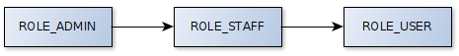
Spring Security – Authorities' Hierarchy
In an hierarchy the upper level authorities include the lower ones
ROLE_ADMIN (grants ROLE_STAFF and ROLE_USER)
ROLE_STAFF (grants ROLE_USER)
ROLE_USER

Slide 90
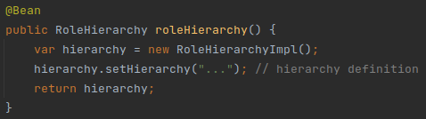
Spring Security – Hierarchy Definition
The hierarchy can be defined using a bean

Slide 91
Spring Security – Hierarchy Definition
The hierarchy can be defined using a bean
Where the definition string is
<upper> > <lower> [ > <lower>]

Slide 92
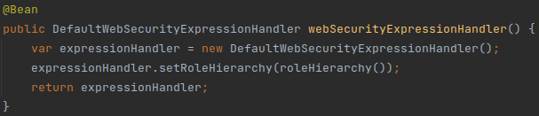
Spring Security – Hierarchy Usage
Define an expression handler that uses the defined hierarchy

Slide 93
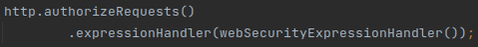
Spring Security – Hierarchy Usage
Define an expression handler that uses the defined hierarchy
Add it to the security filter

Slide 94
Spring Security – Exercise Basic #4 part 3
Define the roles' hierarchy
Simplify the roles requirements in the users' details definition
Branch: security-basic/exercise_4_part_3

Slide 95
Security – Basic
Intro
Configuration
Default User
In Memory User
Password Encoding
Authorization
Database Integration
Annotations

Slide 96
Spring Security – Database Integration
Needed Information
username
password
Optional Information
activation status
roles / authorities (recommended)

Slide 97
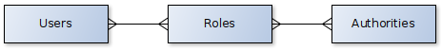
Spring Security – Database Schema
Full Schema

Slide 98
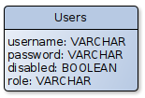
Spring Security – Database Schema
Full Schema
Lazy Schema
using hierarchy definition
Security Basic / Database

Slide 99
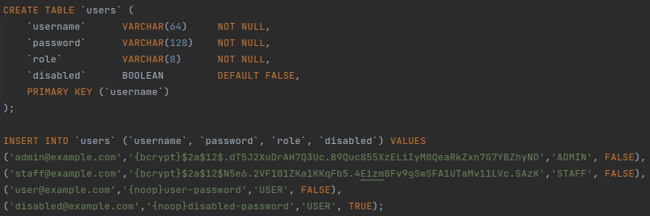
Spring Security – Database Schema Migration

Slide 100
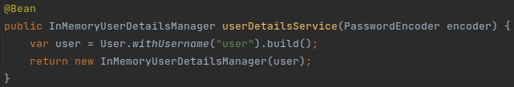
Spring Security – UserDetailsService
InMemory

Slide 101
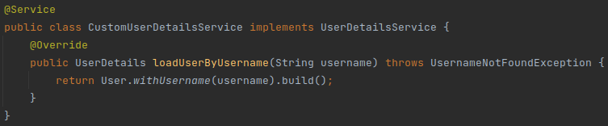
Spring Security – UserDetailsService
InMemory
Service

Slide 102
Spring Security – UserDetails
Builder

Slide 103
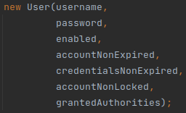
Spring Security – UserDetails
Builder
Constructor

Slide 104
Spring Security – Exercise Basic #5
Provide the dynamic UserDetails using the UserDetailsService
Branch: security-basic/exercise_5

Slide 105
Security – Basic
Intro
Configuration
Default User
In Memory User
Password Encoding
Authorization
Database Integration
Annotations

Slide 106
Spring Security – Annotations
Annotations' enabling annotation
@EnableGlobalMethodSecurity

Slide 107
Spring Security – Annotations
Annotations' enabling annotation
@EnableGlobalMethodSecurity
Configuration
prePostEnabled (true| false)
securedEnabled (true| false)
jsr250Enabled (true| false)

Slide 108
Spring Security – Annotations
prePostEnabled
@PreAuthorize @PostAuthorize - method invocation control
@PreFilter @PostFilter - collections' response filtering

Slide 109
Spring Security – Annotations
prePostEnabled
@PreAuthorize @PostAuthorize - method invocation control
@PreFilter @PostFilter - collections' response filtering
securedEnabled
@Secured - method invocation control

Slide 110
Spring Security – Annotations
prePostEnabled
@PreAuthorize @PostAuthorize - method invocation control
@PreFilter @PostFilter - collections' response filtering
securedEnabled
@Secured - method invocation control
jsr250Enabled
@RoleAllowed - method invocation control

Slide 111
Spring Security – Annotations - [Per|Post]Authorize
Usage
@[Pre|Post]Authorize("<rule>")

Slide 112
Spring Security – Annotations - [Per|Post]Authorize
Usage
@[Pre|Post]Authorize("<rule>")
Rules
isAnonymous()
isAuthenticated()
permitAll()
hasRole('<role>')
hasAuthority('<authority>')
...

Slide 113
Spring Security – Annotations - Secured
Usage
@Secured("<role>")

Slide 114
Spring Security – Annotations - Secured
Usage
@Secured("<role>")
Example
ROLE_ADMIN
ROLE_STAFF
ROLE_USER

Slide 115
Spring Security – Annotations - RolesAllowed
Usage
@RolesAllowed("<role>")
@RolesAllowed({"<role>", "<role>"})

Slide 116
Spring Security – Annotations - RolesAllowed
Usage
@RolesAllowed("<role>")
@RolesAllowed({"<role>", "<role>"})
Example
ROLE_ADMIN
ROLE_STAFF
ROLE_USER

Slide 117
Spring Security – Exercise Basic #6
Activate desired annotations with @EnableGlobalMethodSecurity
Secure endpoints with annotations:
GET /default/open: open
GET /default/authenticated: authenticated (already true, see comments)
GET /default/roles: authenticated (already true, see comments)
DELETE /message: ADMIN
POST /message: STAFF
PUT /message: STAFF
GET /message: USER
Branch: security-basic/exercise_6

Slide 118
Lunch Time

Slide 119
Security – OAuth2

Slide 120
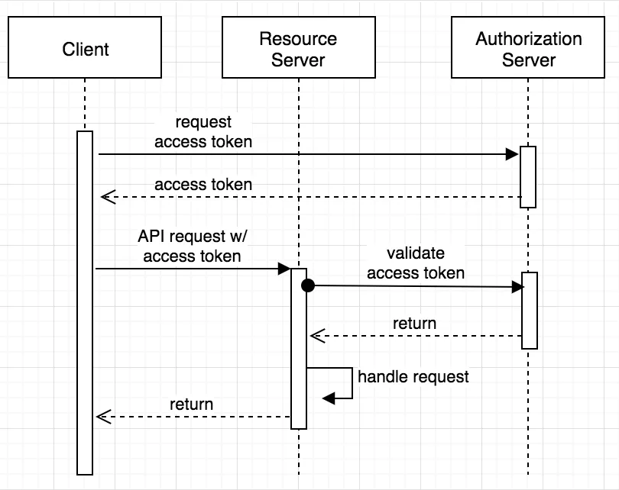
OAuth 2.0
Delegate Authorization of User
Not usable for authentication
Source: https://developer.okta.com/blog/2018/04/02/client-creds-with-spring-boot

Slide 121
OAuth 2.0 - Authorization Server
https://console.cloud.google.com
Create Project
Create Consent Screen
Create Test user
Branch: oauth/exercise

Slide 122
15 minutes break

Slide 123
Error Handling

Slide 124
Error Handling
Default Message Customization
Exception Management
Advanced Options

Slide 125
Error Handling
Default Message Customization
Exception Management
Advanced Options

Slide 126
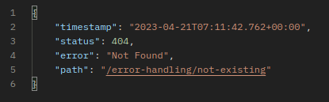
Default Not Found Page
Spring Boot Rest provides an automatic response message if the page searched doesn't exists

Slide 127
Default Error Page
Given a not handled exception

Slide 128
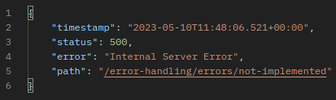
Default Error Page
Given a not handled exception
The default return code is 500

Slide 129
Error Message Customization – Properties
server.error.path (/error)
Path of the error controller

Slide 130
Error Message Customization – Properties
server.error.path (/error)
Path of the error controller
server.error.whitelabel.enabled (true | false)
Provides the default HTML error page or relies on the container's default one (for example tomcat)

Slide 131
Error Message Customization – Properties
server.error.path (/error)
Path of the error controller
server.error.whitelabel.enabled (true | false)
Provides the default HTML error page or relies on the container's default one (for example tomcat)
server.error.include-exception (true | false)
Includes the exception type in the default response

Slide 132
Error Message Customization – Properties
server.error.path (/error)
Path of the error controller
server.error.whitelabel.enabled (true | false)
Provides the default HTML error page or relies on the container's default one (for example tomcat)
server.error.include-exception (true | false)
Includes the exception type in the default response
server.error.include-stacktrace (always | never | on-param)
Shows the error stacktrace in the default response

Slide 133
Error Message Customization – Properties
server.error.path (/error)
Path of the error controller
server.error.whitelabel.enabled (true | false)
Provides the default HTML error page or relies on the container's default one (for example tomcat)
server.error.include-exception (true | false)
Includes the exception type in the default response
server.error.include-stacktrace (always | never | on-param)
Shows the error stacktrace in the default response
server.error.include-message (always | never | on-param)
Shows the error message of the exception if present

Slide 134
Error Message Customization – Response Status
Any custom exception can be annotated with
@ResponseStatus

Slide 135
Error Message Customization – Response Status
Any custom exception can be annotated with
@ResponseStatus
It Allows to define
default HttpStatus to return
generic error reason (aka message)

Slide 136
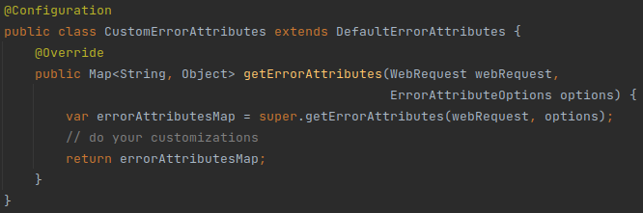
Error Message Customization – DefaultErrorAttributes
Another way to customize the default error message is to provide a Configuration bean that extends DefaultErrorAttributes

Slide 137
Spring Exception – Exercise #1
Add exception and message to response with properties configuration
Customize Status Code and Message with @ResponseStatus
Add locale info using DefaultErrorAttributes
Branch: error-handling/exercise_1

Slide 138
Error Handling
Default Message Customization
Exception Management
Advanced Options

Slide 139
Error Message Customization – ResponseStatusException
Spring 5+ provides a dedicated unchecked exception
ResponseStatusException

Slide 140
Error Message Customization – ResponseStatusException
Spring 5+ provides a dedicated unchecked exception
ResponseStatusException
It can be used instead of @ResponseStatus for externally defined exceptions or just to use inside the control flow

Slide 141
Error Message Customization – ResponseStatusException
Spring 5+ provides a dedicated unchecked exception
ResponseStatusException
It can be used instead of @ResponseStatus for externally defined exceptions or just to use inside the control flow
Constructor's parameters
HttpStatus (required)
Reason message (optional)
Throwable cause (optional)

Slide 142
Error Message Customization – ExceptionHandler
It is possible to define in each controller a method that takes care of a particular exception using @ExceptionHandler

Slide 143
Error Message Customization – ExceptionHandler
It is possible to define in each controller a method that takes care of a particular exception using @ExceptionHandler
It takes as argument the list of exceptions to handle

Slide 144
Error Message Customization – ExceptionHandler
It is possible to define in each controller a method that takes care of a particular exception using @ExceptionHandler
It takes as argument the list of exceptions to handle
The handler method can receive as optional parameters
The throwed Exception (base class if multiple)
The request HttpServletRequest that generated the error

Slide 145
Error Message Customization – ExceptionHandler
It is possible to define in each controller a method that takes care of a particular exception using @ExceptionHandler
It takes as argument the list of exceptions to handle
The handler method can receive as optional parameters
The throwed Exception (base class if multiple)
The request HttpServletRequest that generated the error
The handler method can return any type response

Slide 146
Spring Exception– Exercise #2
Use a try-catch and throw a ResponseStatusException with
Status code: Locked
Reason: The resource cannot be accesses
Branch: error-handling/exercise_2

Slide 147
Spring Exception– Exercise #2 part 2
Create a method annotated with @ExceptionHandler that manages CustomLockedException and returns:
Locked status code
Response message with
Code: RESOURCE_LOCKED
Message: The resource cannot be accessed
Branch error-handling/exercise_2_part_2

Slide 148
Error Message Customization – ControllerAdvice
A class annotated with @ControllerAdvice extends the exception handling to any controller in the application

Slide 149
Error Message Customization – ControllerAdvice
A class annotated with @ControllerAdvice extends the exception handling to any controller in the application
In the REST context it is possible to use @RestControllerAdvice
Syntactic sugar for @ControllerAdvice + @ResponseBody

Slide 150
Error Message Customization – ControllerAdvice
A class annotated with @ControllerAdvice extends the exception handling to any controller in the application
In the REST context it is possible to use @RestControllerAdvice
Syntactic sugar for @ControllerAdvice + @ResponseBody
This means that a method annotated with @ExceptionHandler can be moved in this class and become globally available

Slide 151
Error Handling
Default Message Customization
Exception Management
Advanced Options

Slide 152
Advanced Customization – Putting All Together
What we have
A way to manage exception with custom responses (@ExceptionHandler)
And make it globally (@RestControllerAdvice)
A way to dynamically return status codes (ResponseStatusException)

Slide 153
Advanced Customization – Putting All Together
What we have
A way to manage exception with custom responses (@ExceptionHandler)
And make it globally (@RestControllerAdvice)
A way to dynamically return status codes (ResponseStatusException)
What we want
Provide a consistent error response for our apis
Have a dynamic way to define status codes and error messages
Have a dynamic way to log errors (!= api error messages)

Slide 154
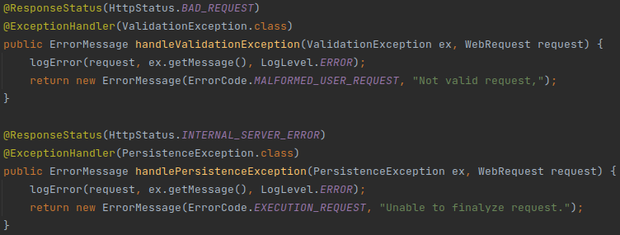
Advanced Customization – Putting All Together
Solution
Use @ExceptionHandler inside @RestControllerAdvice to provide custom responses and error logging for standard exceptions

Slide 155
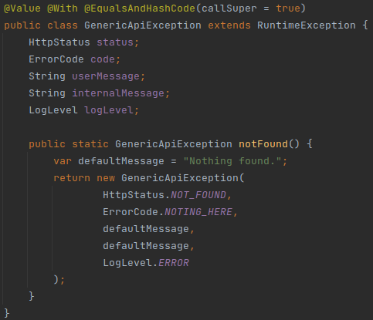
Advanced Customization – Putting All Together
Solution
Use @ExceptionHandler inside @RestControllerAdvice to provide custom responses and error logging for standard exceptions
Create a custom exception that can be thrown from anywhere where it is possible to customize
Loggin message
Response Message
Status Code
Etc

Slide 156
Spring Exception– Exercise #3
Throw the GenericApiException and manage it with @ExceptionHandler
Status code: NOT_FOUND
Logged message: Droids are safe
Logging Level: WARNING
Response Message: "These are not the droids you are looking for"
Response Code: NOTING_HERE
Branch: error-handling/exercise_2

Slide 157
Advanced
ResponseEntityExceptionHandler
It is an useful base class for any @ControllerAdvice (reccomended)
It already handles for a lot of generic exceptions
HttpRequestMethodNotSupportedException
HttpMediaTypeNotSupportedException
HttpMessageNotReadableException
HttpMessageNotWritableException
NoHandlerFoundException
AsyncRequestTimeoutException
...

Slide 158
Advanced
ResponseEntityExceptionHandler
It is an useful base class for any @ControllerAdvice (reccomended)
It already handles for a lot of generic exceptions
HttpRequestMethodNotSupportedException
HttpMediaTypeNotSupportedException
HttpMessageNotReadableException
HttpMessageNotWritableException
NoHandlerFoundException
AsyncRequestTimeoutException
...
BasicErrorController
Is the controller responsible to manage the /error page
It can be extended to add more customization for errors

Slide 159
Advanced – Use Case
All endpoints use json but I want to return consistent errors for xml

Slide 160
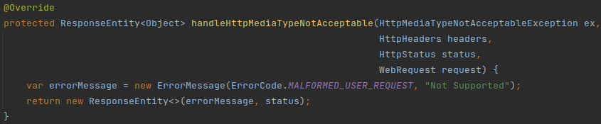
Advanced – Use Case
All endpoints use json but I want to return consistent errors for xml
On @ControllerAdvice (extends ResonseEntityExceptionHandler)

Slide 161
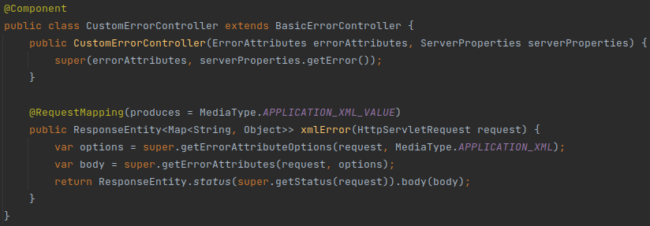
Advanced – Use Case
All endpoints use json but I want to return consistent errors for xml
On @ControllerAdvice (extends ResonseEntityExceptionHandler)
On BasicErrorController

Slide 162
Advanced – Hands On
Just try the rest call
Relevant Classes
ApplicationExceptionHandler#handleHttpMediaTypeNotAcceptable
CustomErrorControlles
Needed extra configuration
error-handling pom -> xml dependency
WebConfig -> message converters and default content type
Branch: error-handling/advanced

Slide 163
15 minutes break

Slide 164
Monitoring

Slide 165
Monitoring
Intro
Actuator
Metrics
Admin

Slide 166
Monitoring
Intro
Actuator
Metrics
Admin

Slide 167
Monitoring
Why Are we interested in monitoring?
Ensure availability
Generate alerts
Performance analysis

Slide 168
Monitoring
Why Are we interested in monitoring?
Ensure availability
Generate alerts
Performance analysis
The monitoring operations can be heavy
The service usually provides only the data
There is another system that collects, analyses and shows this data to an user

Slide 169
Monitoring
Intro
Actuator
Metrics
Admin

Slide 170
Spring Actuator
Defines a lot of production-ready features, not only monitoring

Slide 171
Spring Actuator
Defines a lot of production-ready features, not only monitoring
Accessible by
Http
Jmx

Slide 172
Spring Actuator
Defines a lot of production-ready features, not only monitoring
Accessible by
Http
Jmx
Base url: /actuator

Slide 173
Spring Actuator – Endpoints
/health
Health information

Slide 174
Spring Actuator – Endpoints
/health
Health information
/info
Application information

Slide 175
Spring Actuator – Endpoints
/health
Health information
/info
Application information
/flyway, /liquibase
Migration information

Slide 176
Spring Actuator – Endpoints
/health
Health information
/info
Application information
/flyway, /liquibase
Migration information
/metrics
Metrics information (just names, data depends on monitoring system)

Slide 177
Spring Actuator – Endpoints
/health
Health information
/info
Application information
/flyway, /liquibase
Migration information
/metrics
Metrics information (just names, data depends on monitoring system)
/shutdown
Can be used to shut down the application

Slide 178
Spring Actuator – Endpoints
/health
Health information
/info
Application information
/flyway, /liquibase
Migration information
/metrics
Metrics information (just names, data depends on monitoring system)
/shutdown
Can be used to shut down the application
More endpoints are available

Slide 179
Spring Actuator – Configuration
Generic configuration
management.endopints.enabled-by-default (true|false)

Slide 180
Spring Actuator – Configuration
Generic configuration
management.endopints.enabled-by-default (true|false)
Configure single endpoint
management.endopint.<name>.enabled (true|false)

Slide 181
Spring Actuator – Configuration
Generic configuration
management.endopints.enabled-by-default (true|false)
Configure single endpoint
management.endopint.<name>.enabled (true|false)
Expose endpoints
management.endopints.<technology>.exposure.include (<name> [,<name>|*])
management.endopints.<technology>.exposure.exclude (<name> [,<name>|*])
With technology
web
jmx

Slide 182
Spring Actuator – Security
If Spring Security is in the class-path and no custom security is defined
all the endpoints but /health are automatically secured and CSRF is enabled

Slide 183
Spring Actuator – Security
If Spring Security is in the class-path and no custom security is defined
all the endpoints but /health are automatically secured and CSRF is enabled
If a custom SecurityFilterChain is defined the auto-configuration is not loaded and the endpoints must be manually secured

Slide 184
Spring Actuator – Security
If Spring Security is in the class-path and no custom security is defined
all the endpoints but /health are automatically secured and CSRF is enabled
If a custom SecurityFilterChain is defined the auto-configuration is not loaded and the endpoints must be manually secured
CORS can be configured by using
management.endpoints.web.cors.allowed-origins (<url> [,<url>])
management.endpoints.web.cors.allowed-methods (<method> [,<method>])
etc..

Slide 185
Spring Monitoring – Exercise #1
Activate the following endpoints and see the response data
Health
Info
Flyway
Env
Metrics
Beans
Mappings
Branch: monitoring/exercise_1

Slide 186
Monitoring
Intro
Actuator
Metrics
Admin

Slide 187
Spring Actuator – Metrics
Spring Actuator provides dependency management and auto-configuration for Micrometer
An application metric facade

Slide 188
Spring Actuator – Metrics
Spring Actuator provides dependency management and auto-configuration for Micrometer
An application metric facade
Supported Monitoring Systems (additional dependencies needed)
Dynatrace
Elastic
Prometheus
...

Slide 189
Spring Actuator – Prometheus
As metrics example will be used Prometheus
Because it exposes an endpoint to get the data and down not need other systems involved

Slide 190
Spring Actuator – Prometheus
As metrics example will be used Prometheus
Because it exposes an endpoint to get the data and down not need other systems involved
Get endpoint available at /actuator/prometheus
After enabling and micrometer dependency added

Slide 191
Spring Actuator – Prometheus – Metrics
System metrics
jvm_memory_[...], jvm_threads_[…], jvm_buffer_[…]
system_cpu_[…]
process_[…]
disk_[…]

Slide 192
Spring Actuator – Prometheus – Metrics
System metrics
jvm_memory_[...], jvm_threads_[…], jvm_buffer_[…]
system_cpu_[…]
process_[…]
disk_[…]
Database
spring_data_repository_[…]
hikaricp_connections_[…]

Slide 193
Spring Actuator – Prometheus – Metrics
System metrics
jvm_memory_[...], jvm_threads_[…], jvm_buffer_[…]
system_cpu_[…]
process_[…]
disk_[…]
Database
spring_data_repository_[…]
hikaricp_connections_[…]
Server
tomcat_sessions_[…]
http_server_requests_[…]

Slide 194
Spring Monitoring – Exercise #2
Play with the actuator and service endpoints to see the metrics change
Branch: monitoring/exercise_2

Slide 195
Monitoring
Intro
Actuator
Metrics
Admin

Slide 196
Spring Boot Admin
Spring Boot Admin is a web application used for monitoring and managing Spring application

Slide 197
Spring Boot Admin
Spring Boot Admin is a web application used for monitoring and managing Spring application
Each Application is a client and register itself to the admin server

Slide 198
Spring Boot Admin
Spring Boot Admin is a web application used for monitoring and managing Spring application
Each Application is a client and register itself to the admin server
The monitoring and managing is given by Spring Actuator

Slide 199
Spring Boot Admin – Server
The server can be enable with the annotation
@EnableAdminServer

Slide 200
Spring Boot Admin – Server
The server can be enable with the annotation
@EnableAdminServer
Spring Security must be configured
Default user or more specific way

Slide 201
Spring Boot Admin – Server
The server can be enable with the annotation
@EnableAdminServer
Spring Security must be configured
Default user or more specific way
Spring Admin configuration must be set to allow client to register

Slide 202
Spring Boot Admin – Server
The server can be enable with the annotation
@EnableAdminServer
Spring Security must be configured
Default user or more specific way
Spring Admin configuration must be set to allow client to register
The UI Is then available at the main server path

Slide 203
Spring Boot Admin – Client
Setup client info (from client to server)
Server url
Username/Password
Username/Password metadata (sent to server to connect to client)

Slide 204
Spring Boot Admin – Client
Setup client info (from client to server)
Server url
Username/Password
Username/Password metadata (sent to server to connect to client)
Spring Security must be configured
Default user or more specific way

Slide 205
Spring Boot Admin – Client
Setup client info (from client to server)
Server url
Username/Password
Username/Password metadata (sent to server to connect to client)
Spring Security must be configured
Default user or more specific way
The actuator endpoints must be exposed and secured

Slide 206
Spring Boot Admin – UI
The UI is available at the server context path

Slide 207
Spring Boot Admin – UI
The UI is available at the server context path
At /applications are visible all the clients

Slide 208
Spring Boot Admin – UI
The UI is available at the server context path
At /applications are visible all the clients
At /instances/{id} is possible to access single client data
/details the overview with info, health, medadata, system statistics
/metrics available metrics, it is possible to select which one to see
Etc depending on the exposed endpoints

Slide 209
Spring Boot Admin – Notifications
It is possible to add a notification system
Email
PagerDuty
OpsGenie
HipChat
Slack
Let's Chat

Slide 210
Spring Monitoring – Exercise #3
Play with the Admin UI
Branch: monitoring/exercise_3

Slide 211

So long and thanks for all the fish
Feedback
Weblink: https://de.surveymonkey.com/r/B5NNSMV

Slide 212
Spring Security And Monitoring
​

